Slide 1
FAST SVD
Making your recommendation systems faster
by Borisov Denis, Kalenyuk Akim, and Krasnov Michail
Notes:
As you can see, regular text paragraphs are <em>not</em> visible to your audience. This is by design. Body text is your script. Only you can see it. As you can see later, it will be present in the teleprompter when you present.

Slide 2
Introduction. SVD Algorithm (Singular Value Decomposition) is widely used for recommendation purposes. However, it can be quite slow on large datasets.
That is why, in our team project, we decided to consider various ways of accelerating our algorithm.
The main information source for us was the paper Faster "Matrix Completion Using Randomized SVD" by Xu Feng, Wenjian Yu, and Yaohang Li.
In this paper authors presented the method to accelerate matrix completion using faster randomized singular value decomposition.

Slide 3
In this presentation we will observe
Singular Value Decomposition (SVD)
Randomized Algorithms
Randomized SVD (rSVD)
Algorithms Overview
from rSVD to rSVT (another presentation)
Our results
What is next?
Notes:
These should be reading notes. This kind of slide looks like a lot of work, and it directly sabotages your presentation. It's as if you finished your sentences yourself.

Slide 4
But let's start
From the beginning
Notes:
To make people listen to you, you need a good story. Stories connect. A good story has the power to make people look at the world through your eyes. The door to make them look through your eyes will not get unlocked with stock images, graphs, and bullet lists, but with your voice. </p> <p>You need beginning-middle-end. Your presentation's visuals should help you get attention, make your point, and keep people oriented. With iA Presenter, you don’t <em>design</em> your presentation, you <em>write</em> it.

Slide 5
Singular Value Decomposition
Singular Value Decomposition (SVD) is a matrix factorization method used to uncover the hidden structure within data. It decomposes a matrix into three components: U, Σ (Sigma), and V^{T}, where Σ contains singular values that quantify the significance of data, and U and V represents the left and right singular vectors matrices.
SVD finds crucial application in Matrix Completion, where partial data is observed. Singular Value Thresholding, built upon SVD, plays a pivotal role in addressing this issue. By truncating singular values, it reduces matrix rank while preserving essential information, allowing accurate completion of missing data.
SVD's adaptability and efficiency make it an invaluable tool for diverse scientific fields, providing a pathway to uncover valuable insights and address data recovery challenges.
Notes:
If you play with Markdown for a couple of minutes, you’ll only need help for more difficult matters. Adding a link, footnote, or table requires more skills. To promote familiarity with advanced Markdown, we have added a formatting inspector.

Slide 6
However,
SVD is not perfect!
Indeed, SVD is lack of speed on large datasets.
Notes:
In common presentations, the script is called “notes.” They are squeezed in at the bottom of the page. They’re an afterthought. With iA Presenter, your story is the very essence of every presentation. That doesn't mean that every presentation needs to be a TED talk. But every time you speak, you need to have something to say.</p> <p>Usually, what you want to say already exists in some form. You can paste an existing text, and you are 50% done. All you need are page breaks and visuals. The story-centered text-first approach is what makes iA Presenter so much faster than graphic presentation tools.</p> <p>To create a page break, you simply add three hyphens like this:

Slide 7
Randomized algorithms
What about Random SVD?
Many standard algorithms for dealing with matrices are expensive or intractable in large-scale machine learning and statistics. For example, given an m×n matrix A where both m and n are large, a method such as singular value decomposition (SVD) will require memory and time which is superlinear in m and n. The main idea of randomized algorithms is to build up random, but good approximation for further computations.
- Conventional alg. for dense matrix - O(n² k)
- Conventional alg. for sparse matrix - O(N * k), where N - number of non-zero elements
- Random SVD method reducing the constant

Slide 8
Random SVD algorithm
The goal of a randomized range finder is to produce an orthonormal matrix Q with as few columns as possible such that ∥(I−QQ)A)∥ ≤ ε for the tolerance ε .
The first idea is to watch on low rank matrix in reduced space. The easiest way is using of random projections to obtain main actions of matrix

Slide 9
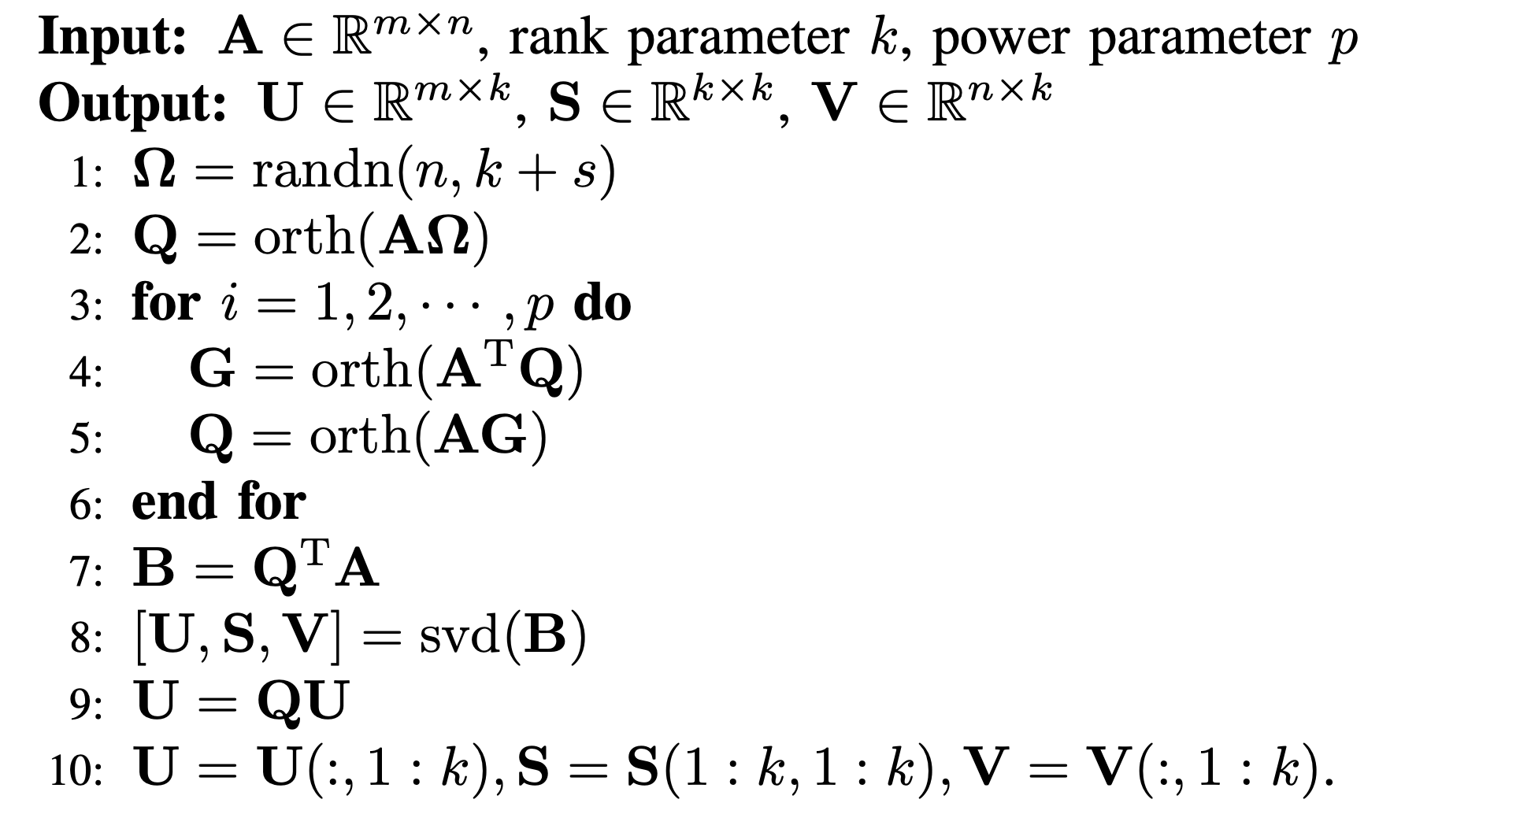
rSVD
Randomized Singular Value Decomposition is an approach to computing the Singular Value Decomposition (SVD) of a matrix using randomization techniques.
It's designed to approximate the dominant singular values and corresponding singular vectors of a matrix, often with significantly reduced computational cost compared to traditional SVD methods. rSVD is particularly useful for large and sparse matrices.
Generate a random Gaussian (or other suitable) matrix and multiply it with the original matrix. This creates a smaller, dense matrix, preserving the matrix's structure while reducing its size.
Compute the SVD of the smaller dense matrix. Since it's smaller, the SVD calculation is less computationally expensive.
Use the results from the SVD of the smaller matrix to approximate the dominant singular values and vectors of the original matrix.
Repeat the process multiple times to refine the approximations:)

Slide 10
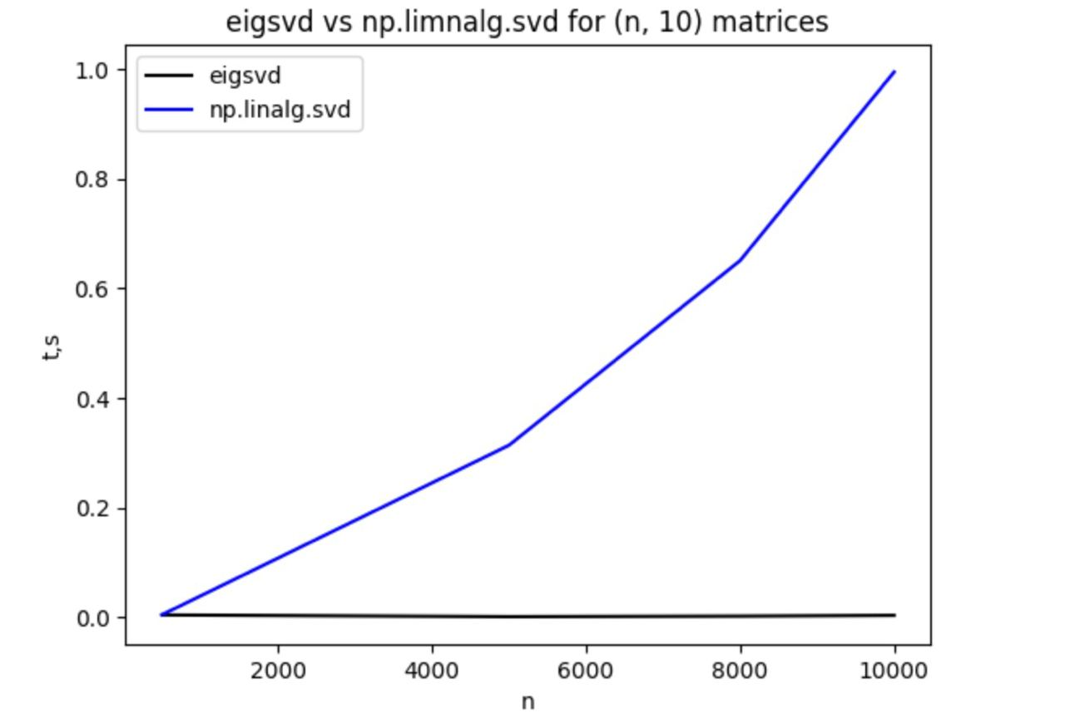
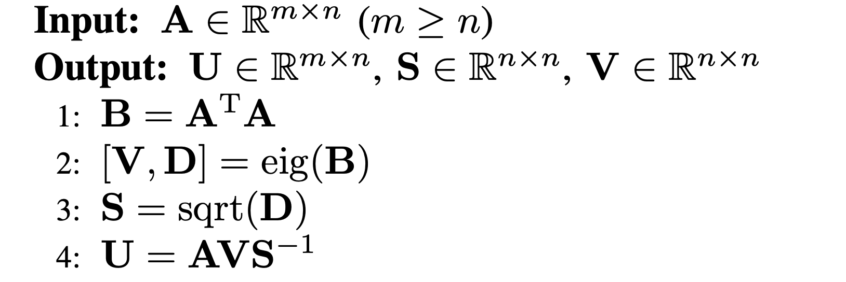
EigSVD
EigSVD is an algorithm designed to extract the underlying structure of a matrix, focusing on its Singular Value Decomposition (SVD). The primary goal is to efficiently compute the SVD of a given matrix, particularly when dealing with matrices where m>>n.

Slide 11
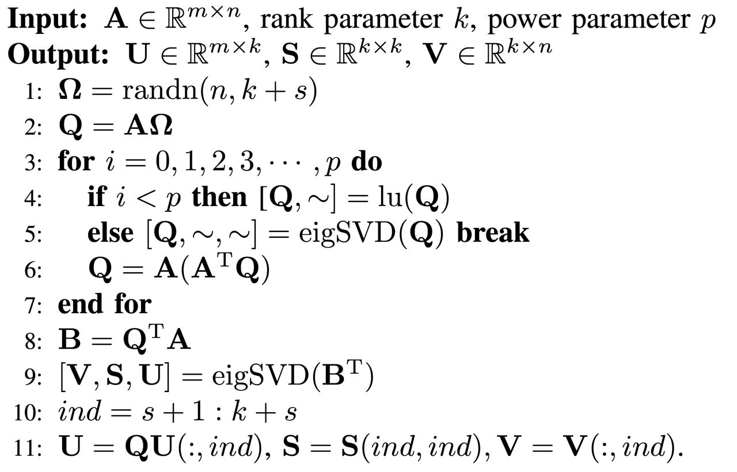
rSVD-PI
The rSVD-PI (Randomized Singular Value Decomposition with Power Iteration) algorithm is used to quickly calculate the SVD (Singular Value Decomposition) of large matrices. It is based on a combination of random projection and power iterations. First, a random projection of the original matrix onto a subspace of a smaller dimension is performed, then power-law iterations are performed to obtain an approximate SVD decomposition. The rsvd-PI algorithm allows you to speed up SVD calculations, especially for large matrices.

Slide 12
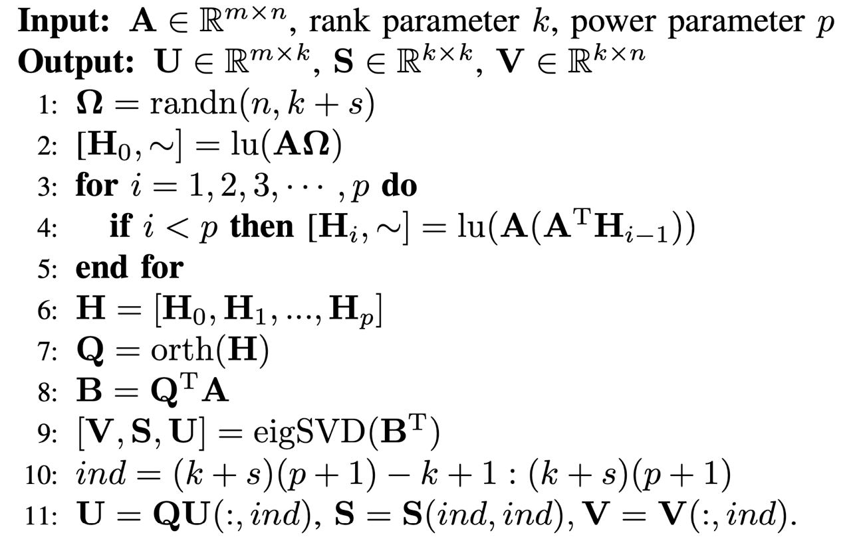
rSVD-BKI
The rSVD-BKI algorithm (Randomized Singular Value Decomposition with Block Krylov Iterations) is also used to quickly calculate large-size SVD matrices. It is based on a combination of random projection and block Krylov methods. Unlike rSVD-PI, rSVD-BKI works with blocks of matrices, which allows you to take into account the structure of the matrix and use it for more efficient calculations. The rSVD-BKI algorithm also allows you to speed up SVD calculations, especially for matrices with a block structure.

Slide 13
Results overview

Slide 14
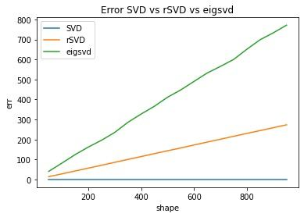
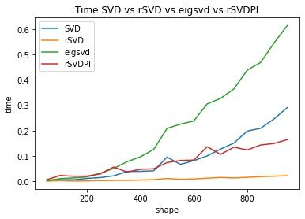
Dense matrices

Slide 15
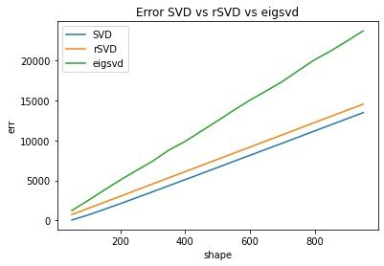
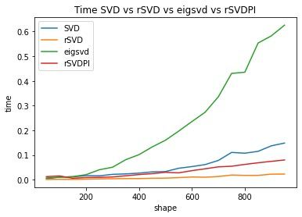
Sparse matrices

Slide 16
For what is it?
Extra presentation is attached!:)

Slide 17
Summary, conclusion, and plans

Slide 18
We have implemented several different randomized algorithms for processing both dense and sparse matrices.
An investigation was conducted to demonstrate the acceleration achieved by our implemented algorithms based on the matrix size and to assess the associated errors.
Despite our plans to implement the fast SVT algorithm, due to time constraints, we were unable to complete this endeavor.
An intriguing avenue for future work would involve applying these developed algorithms to real-world matrices, extending their applicability beyond artificially generated data.

Slide 19
Thank you for the listening!
more detailed information can be found on https://github.com/Akim-collab/fast-rSVD

